Slide 1
Intro to Python Part 1
Benjamin Rudski
April 16, 2025

Slide 2

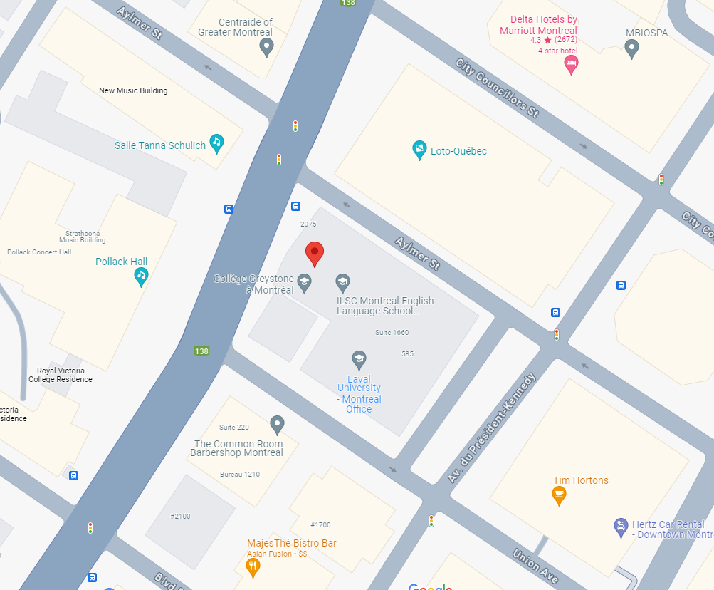
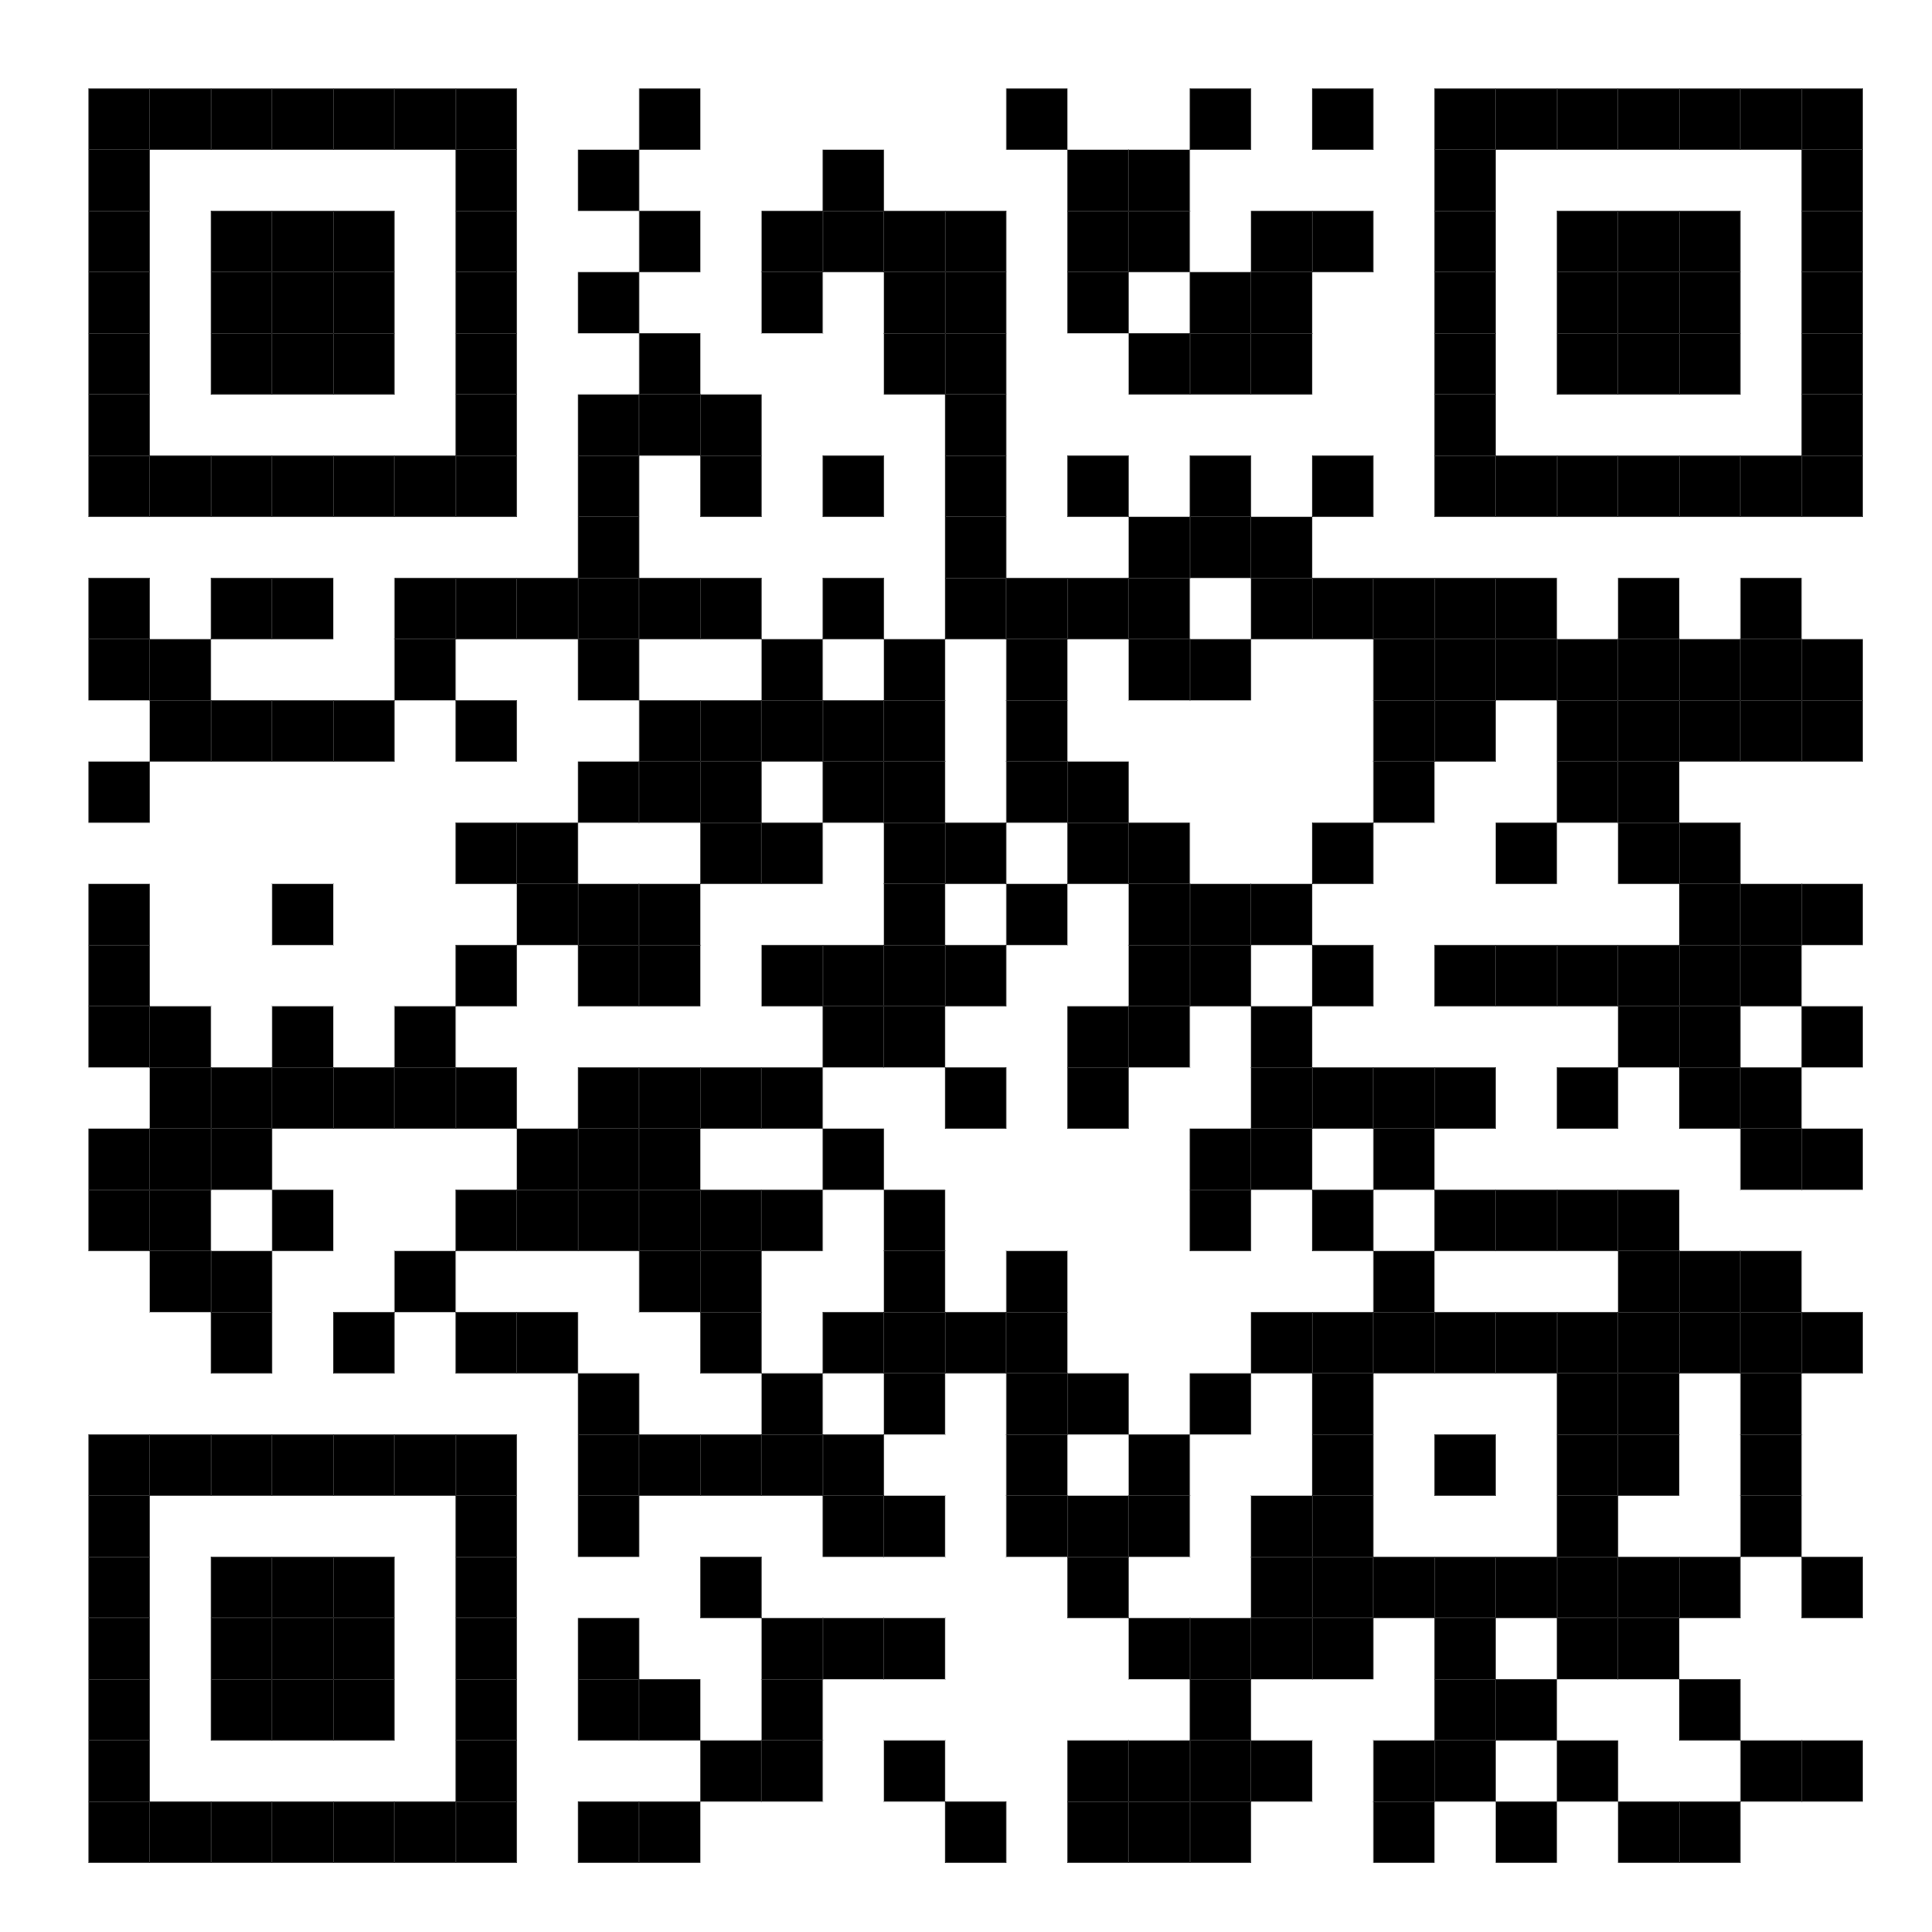
QLS-MiCM mission statement: deliver quality workshops designed to help biomedical researchers develop the skills they need to succeed.
Location: 550 Sherbrooke Street, Montreal, Quebec
Scan the QR code to sign up
for our mailing list
Contact: workshop-micm@mcgill.ca

Slide 3
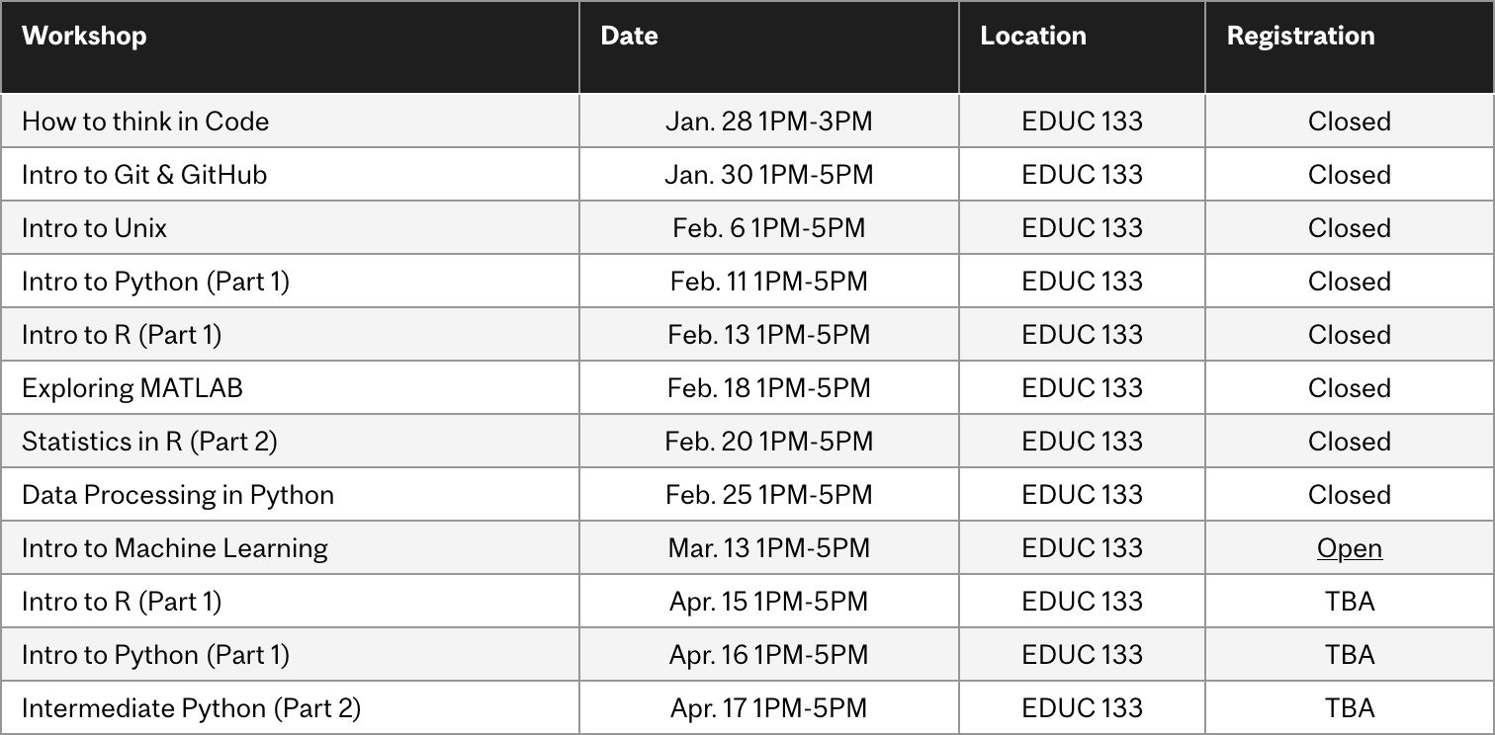
Workshop Series
https://www.mcgill.ca/micm/training/workshops-series

Slide 4
Learning Outcomes
Summary
In this 4-hour workshop, participants will be introduced to the basics of programming in Python. Students will journey from the beginnings of creating variables and performing simple mathematical operations to writing code that can perform fundamental tasks and wrapping this code into functions. Participants will learn how to write the important building blocks that make up complex programs.
Learning Objectives
Store data in variables and collections.
Perform basic operations on these data.
Use control flow and loops to write powerful code.
Define functions to create repeatable units of behaviour.

Slide 5
Outline
Module 1 – Python Basics (1 hour 15 minutes)
Foundations of Python - A Brief Overview of Types and Variables
Numbers and Comparisons
Intro to Control Flow and Loops (if, while and for)
Exercise
Module 2 – Strings and Collections: An Object Primer (1 hour)
Introducing Objects
Introducing the String!
Introduction to Tuples, Lists and Dictionaries
Exercise
Module 3 – Introduction to Functions (45 minutes)
Function Overview
Writing Custom Functions
Documenting Functions
Exercise
Module 4 – Where to go from here (10 minutes)

Slide 6
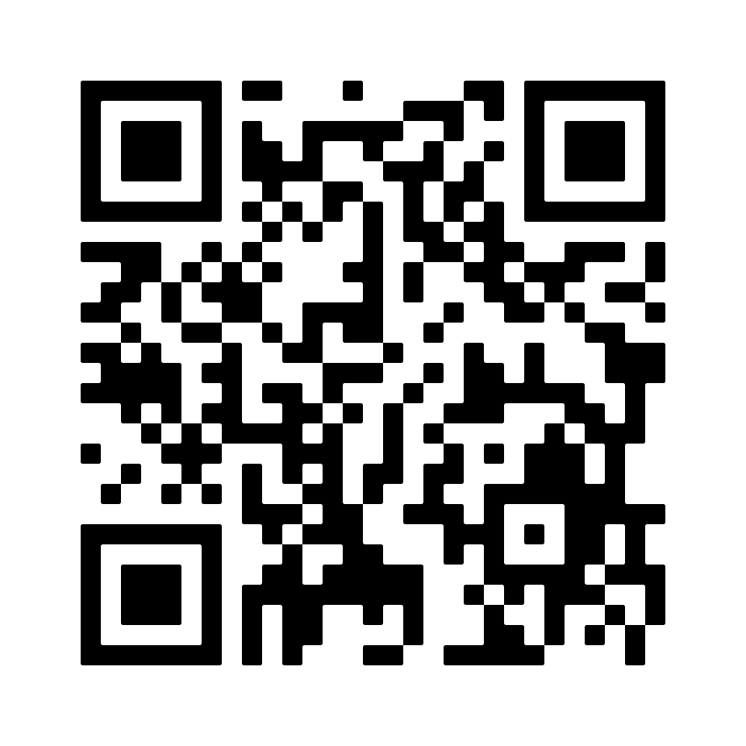
Interactive Workshop!
That’s pretty much all that will be in the slides… For the rest, we’ll go to a Jupyter Notebook:
To the repository!

Slide 7
Module 2 Strings and Collections An Object Primer

Slide 8
What is an Object?
Object
Attributes
Methods
Variables
Describe the object
Functions
Compute values
Alter the object

Slide 9
Objects
Car
colour
year
model
turn_on()
turn_off()
change_gear()
toggle_headlights()
Mouse
height
weight
age
sex
genotype

Slide 10
To summarize
Data can be stored in variables of several types, including strings, integers, floating point numbers and Booleans.
Collection types, such as tuples, lists and dictionaries can be used to store multiple data points.
Control flow and loops help decide which lines to run and allow lines to be repeated.
Functions help package up behaviour into units that you can easily reuse.
Now you are ready to:
Store data in variables and collections.
Perform basic operations on these data.
Use control flow and loops to write powerful code.
Write functions to repeat complicated tasks.

Slide 11
Acknowledgements
Thank you to QLS-MiCM for giving me this opportunity and for helping me along the way.
Thank you to the professors from the McGill School of Computer Science for helping me along my programming journey and for inspiring me to share my programming experience with others.
Thank you to Professor Mathieu Blanchette, whose COMP 204 course helped introduce me to Python (back in Fall 2018).
Thank you to the Python community!

